Slide 1



Slide 2


Heritage
Founded in 1968
By Tom King
Remains privately held by King Family
President Jeff King

Slide 3
History
1988: Pioneered the first marine-grade polymer sheet, King StarBoard®, which remains the dominant brand in the marine industry today
2001: Moved into new 150,000 square-foot state-of-the-art manufacturing facility in North Port, Florida
2011: Opened a warehouse facility in Medford, Oregon to better serve customers in the western U.S.
2018: Expanded North Port Facility to 250,000 Sq. Ft.
1988
King StarBoard®
2001
150,000 Sq. Ft. Facility
2011
Medford Warehouse
2018
Expanded to
250,000 Sq. Ft.

Slide 4
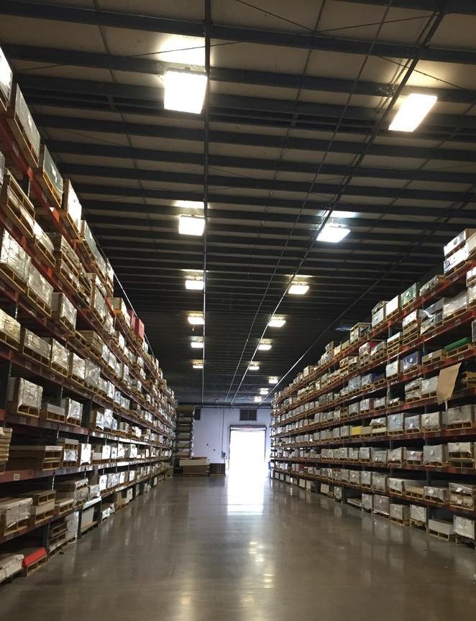
Focus on a Quality Advantage
  Continuously refined through industry-best propriety processes (K-Stran™) using highest quality materials
  Industry-leading tolerances, continuous testing
  Employing & training the best workforce
Today
Customer Service & Support
  Unsurpassed commitment to ship the right product, at the right time, at the right price
  Knowledgeable inside sales team
  Our team excels at product knowledge and developing long-term customer relationships

Slide 5
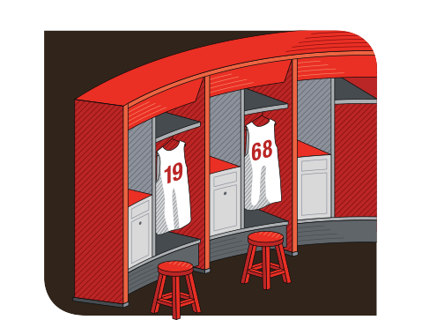
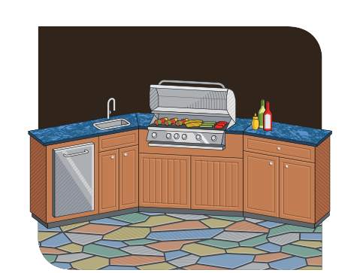
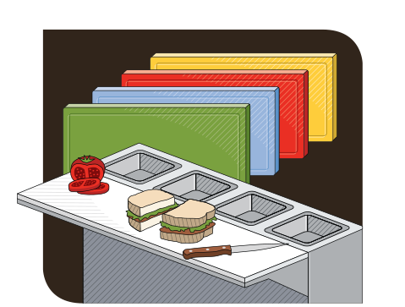
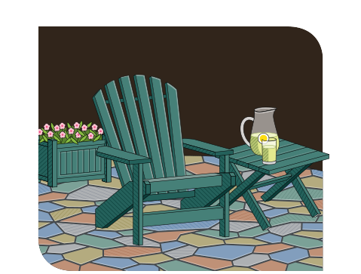

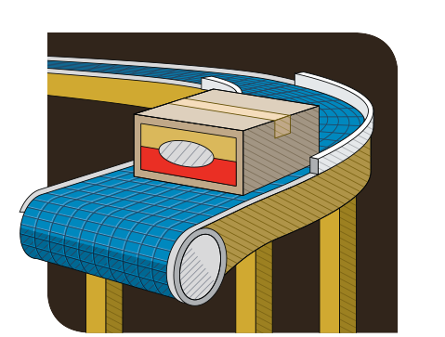
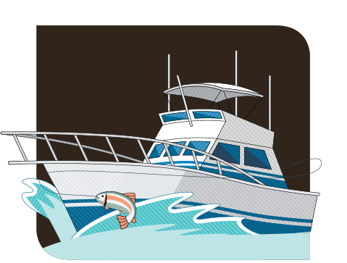
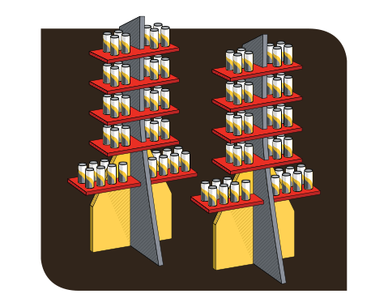
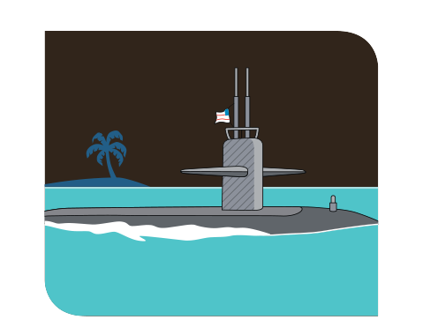



Serving The Following Markets
Indoor Cabinetry
Outdoor Cabinetry
Food Service
Furniture
Healthcare
Manufacturing
Marine
Point-of-Purchase
Neutron Shielding
Parks & Recreation
Industrial
Signage

Slide 6


The Environment
No waste: our polymers are completely recyclable and material waste is recycled back into our products
No harmful dust, just small shavings that can be recycled
No known harmful substances, no carcinogens, no toxins
No off-gassing, and if burned, no harmful gasses are emitted
Outstanding durability maximizes product lifecycle, thus reducing overall impact on our environment
King Plastic products may earn LEED® rating points
*The U.S. Green Building Council's
LEED® green building program is the preeminent program for the design, construction, maintenance and operations of high-performance green buildings. Learn more at usgbc.org

Slide 7
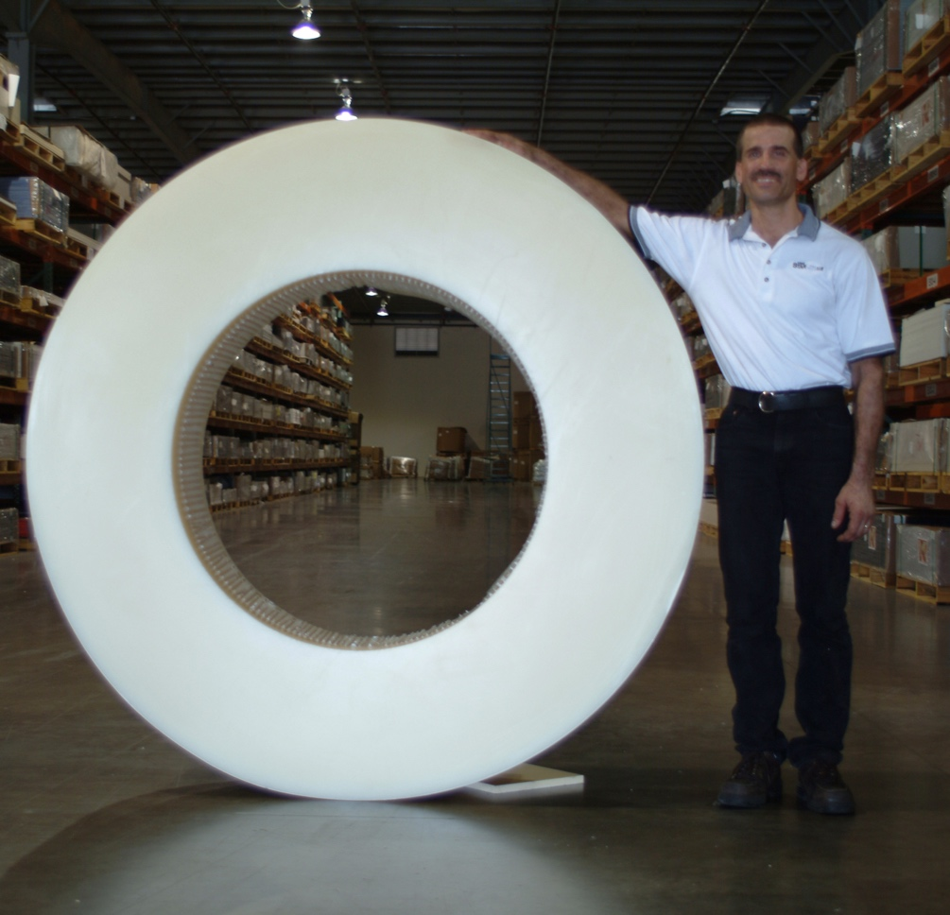
Capabilities
Sheets
  To more than 120’ x 8’
Slabs
  To more than 30” thick
Massive Shapes
  To more than 6,000 lbs.

Slide 8

Antimicrobial & Flame Retardant Available
Lighter in density compared to other flame retardant materials in the industry
Improved in physical properties
Cost effective
ASTM E-84 Class A Flame Compliance and CAN/ULC-S102 for Canadian Compliance
ASTM E-84 is the primary standard used worldwide for contractors, architects and engineers to improve product quality and enhance safety
Bonded at the atomic level throughout the polymer sheet
Does not leach out
Retains its efficacy for life of product
Does not harm the environment
Easy to clean and disinfect

Slide 9
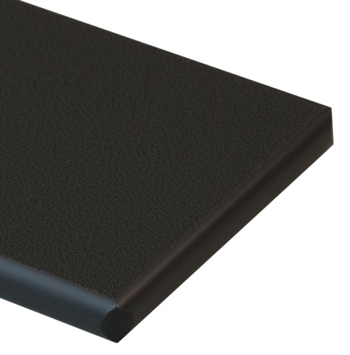
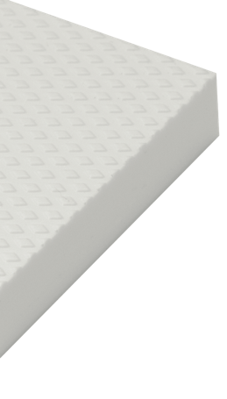
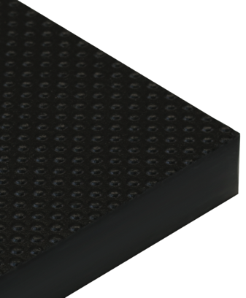
Standard Textures
Matte Finish
King StarBoard®
King ColorCore®
Dot or Diamond
King StarBoard® AS

Slide 10
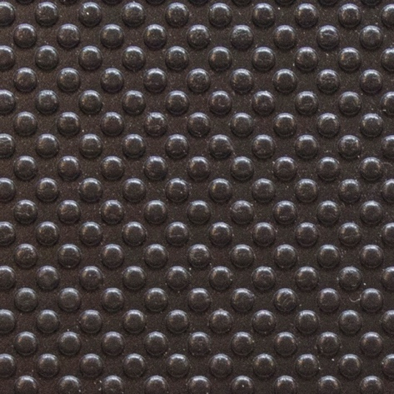

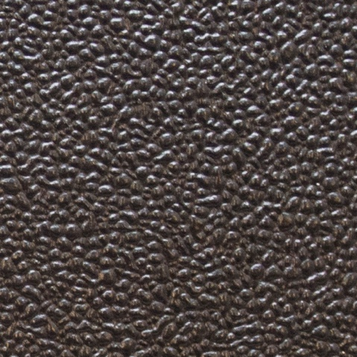
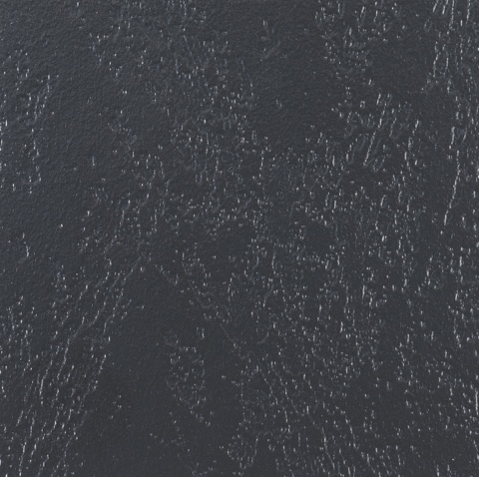
Textures Available on King Plastic Products
Dot
Diamond
Gator Hide
Leather Grain

Slide 11
King StarBoard® Family of Products

Slide 12
The Original Marine-Grade Polymer Sheet
Standard Sheet Sizes: 48” x 96” (Only in 1-1/2” gauge) and 54” x 96”
Standard Gauges: 1/4” | 3/8” | 1/2” | 3/4” | 1” | 1-1/2”
Approximate Weight (54” x 96”): 45 lbs | 67.5 lbs | 90 lbs | 135 lbs | 180 lbs
Standard Colors
Black
Charcoal Gray
Dolphin Gray
Light Gray
Sanshade
Seafoam
Arctic White
White/White

Slide 13

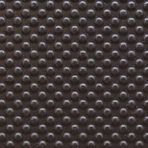
The Anti-Skid Marine-Grade Polymer Sheet
Standard Sheet Size: 54” x 96”
Standard Gauges: 1/2" | 3/4” | 1”
Approximate Weight: 90 lbs | 135 lbs | 180 lbs
Standard Colors
Textures
Black
Charcoal Gray
Dolphin Gray
Light Gray
Sanshade
Seafoam
White/White
Diamond
Dot

Slide 14
The Lightweight Marine-Grade Cellular Sheet
Standard Sheet Size: 60” x 96”
Standard Gauges: 1/4” | 3/8” | 1/2” | 3/4”
Approximate Weight: 40 lbs | 61.5 lbs | 80 lbs | 120 lbs
Standard Colors
Black
Charcoal Gray
Dolphin Gray
Light Gray
Sanshade
Seafoam
White/White

Slide 15
The Lightweight Marine-Grade Cellular Utility Sheet
Standard Sheet Size: 60” x 96”
Standard Gauges: 1/4” | 3/8” | 1/2” | 3/4”
Approximate Weight: 40 lbs | 56 lbs | 72bs | 108 lbs
Standard Colors
Utility Black
Utility Gray
Utility White

Slide 16
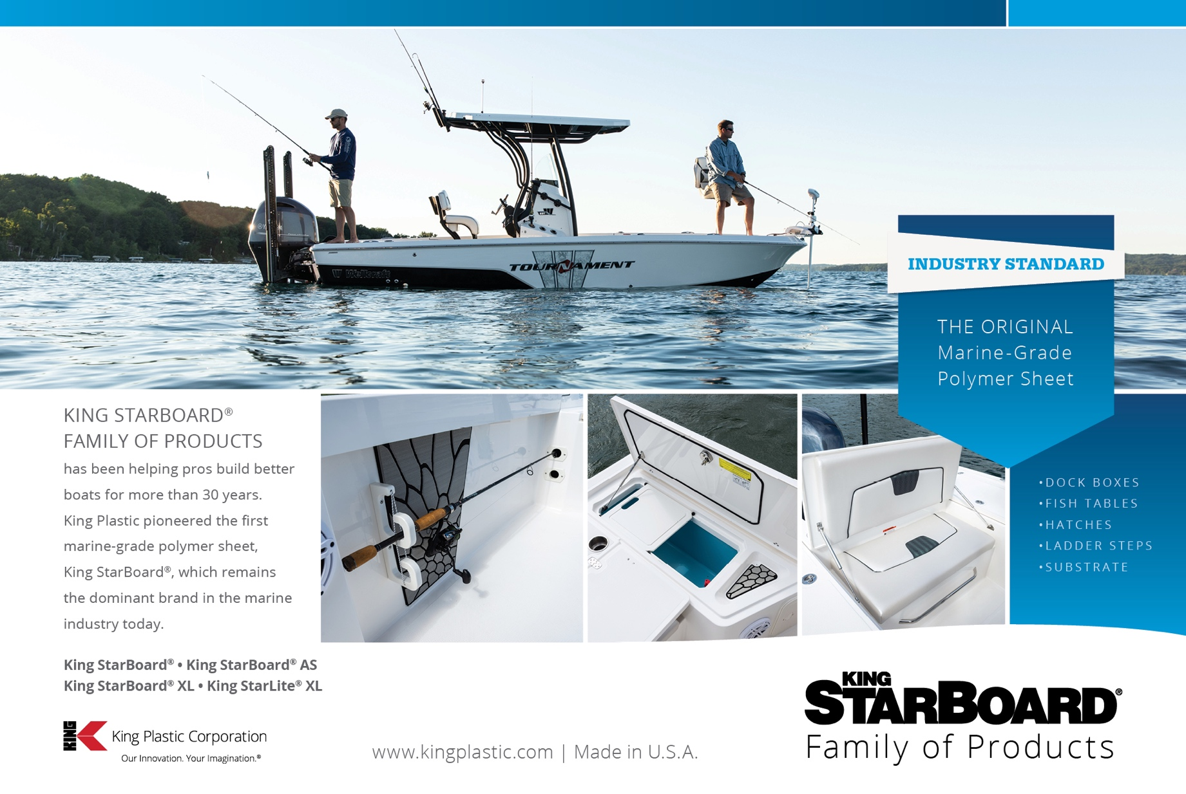
Notes:
Refer to Target Market Flyers and Case Study

Slide 17
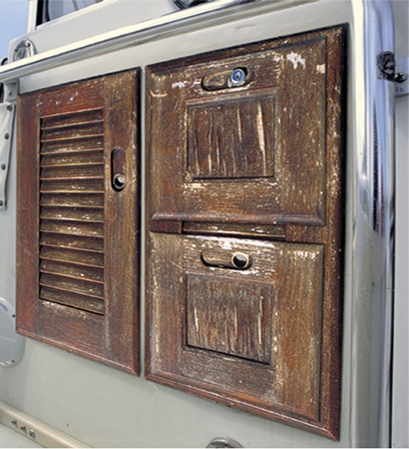
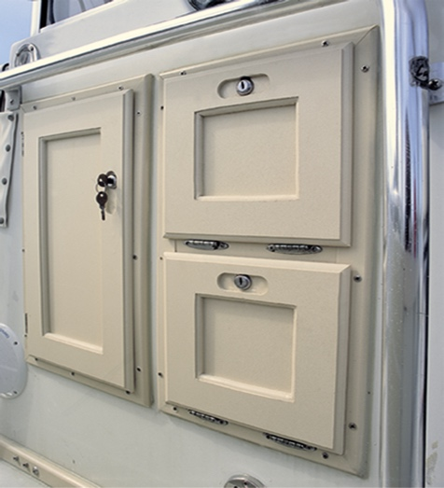
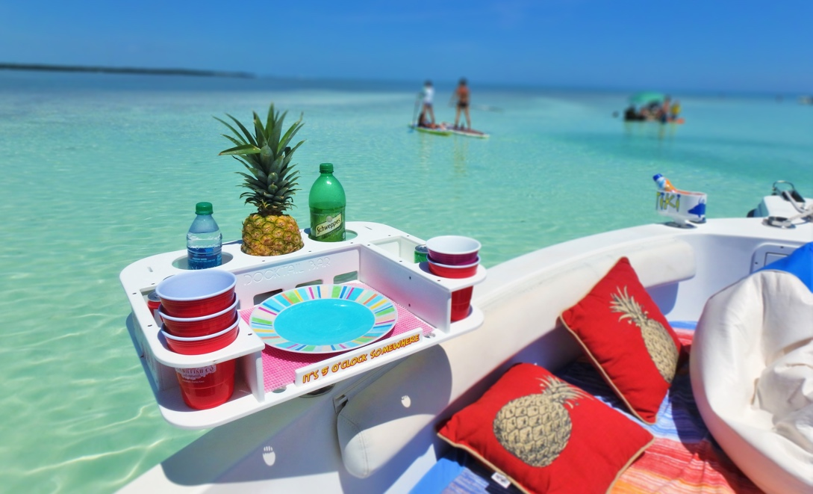
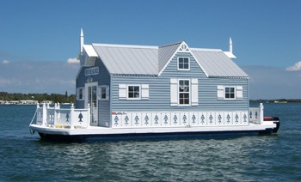
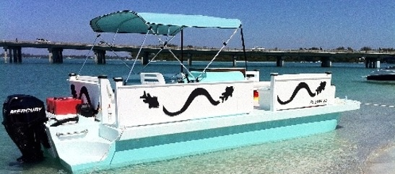
Notes:
Refer to Target Market Flyers and Case Study

Slide 18

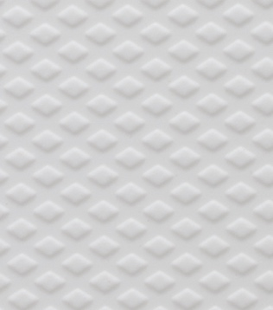
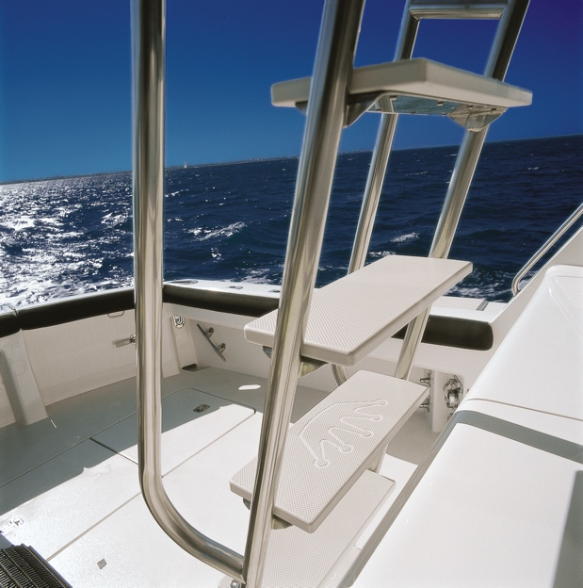
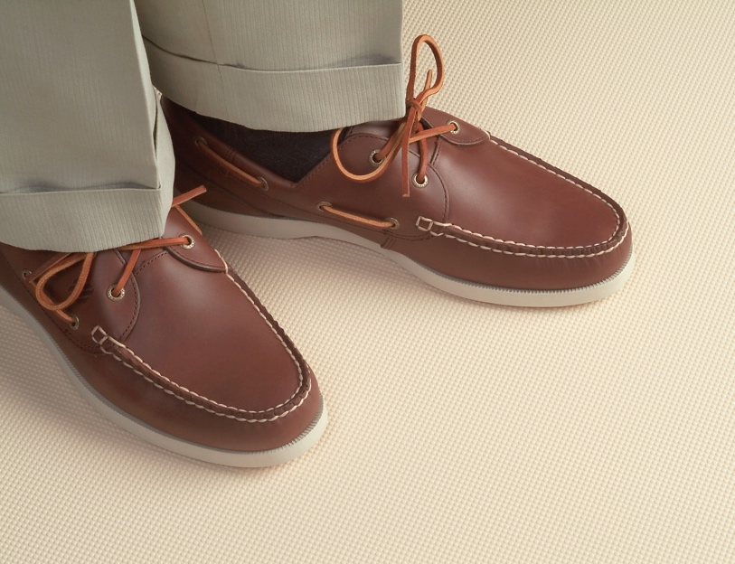
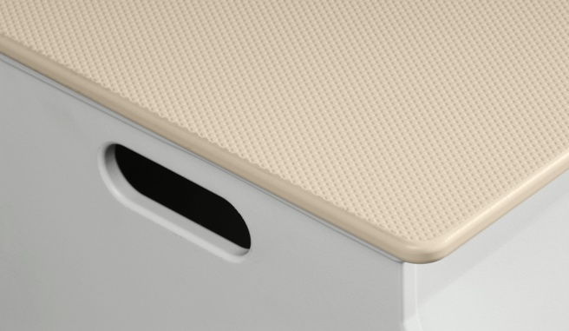
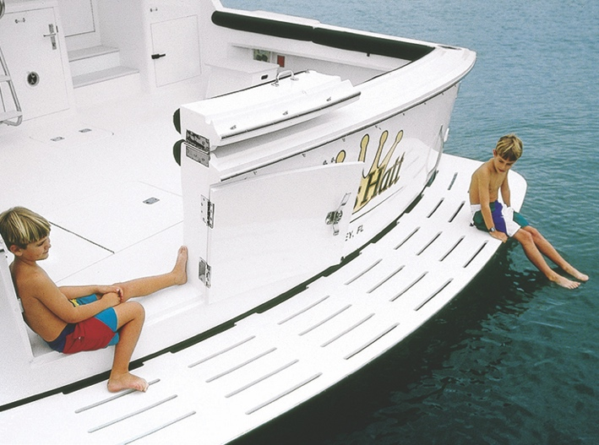
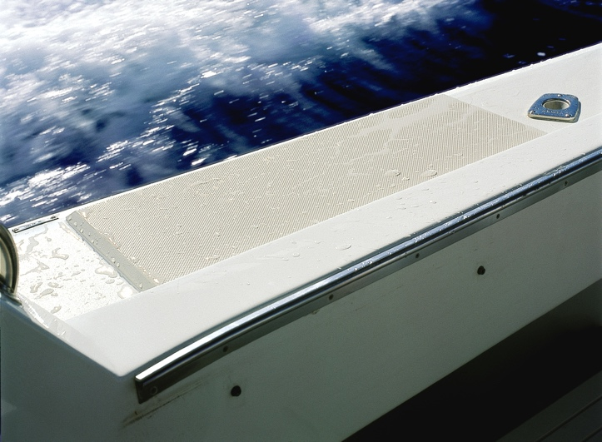
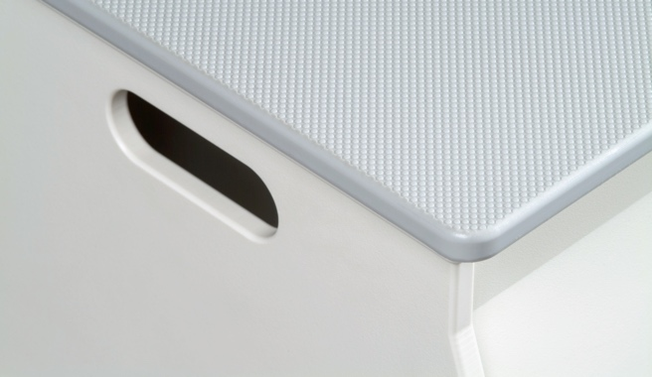
Notes:
Refer to Target Market Flyers and Case Study

Slide 19
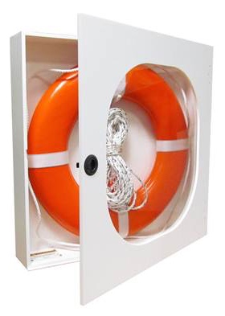
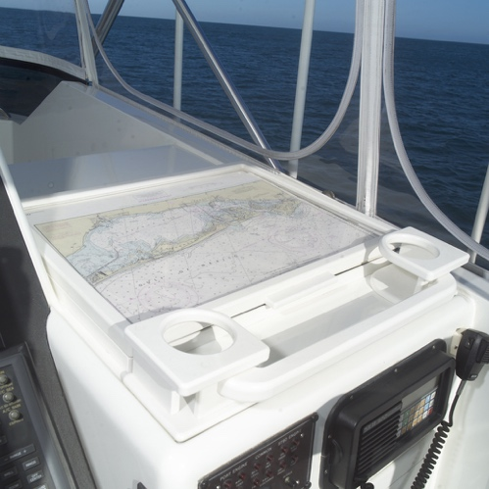
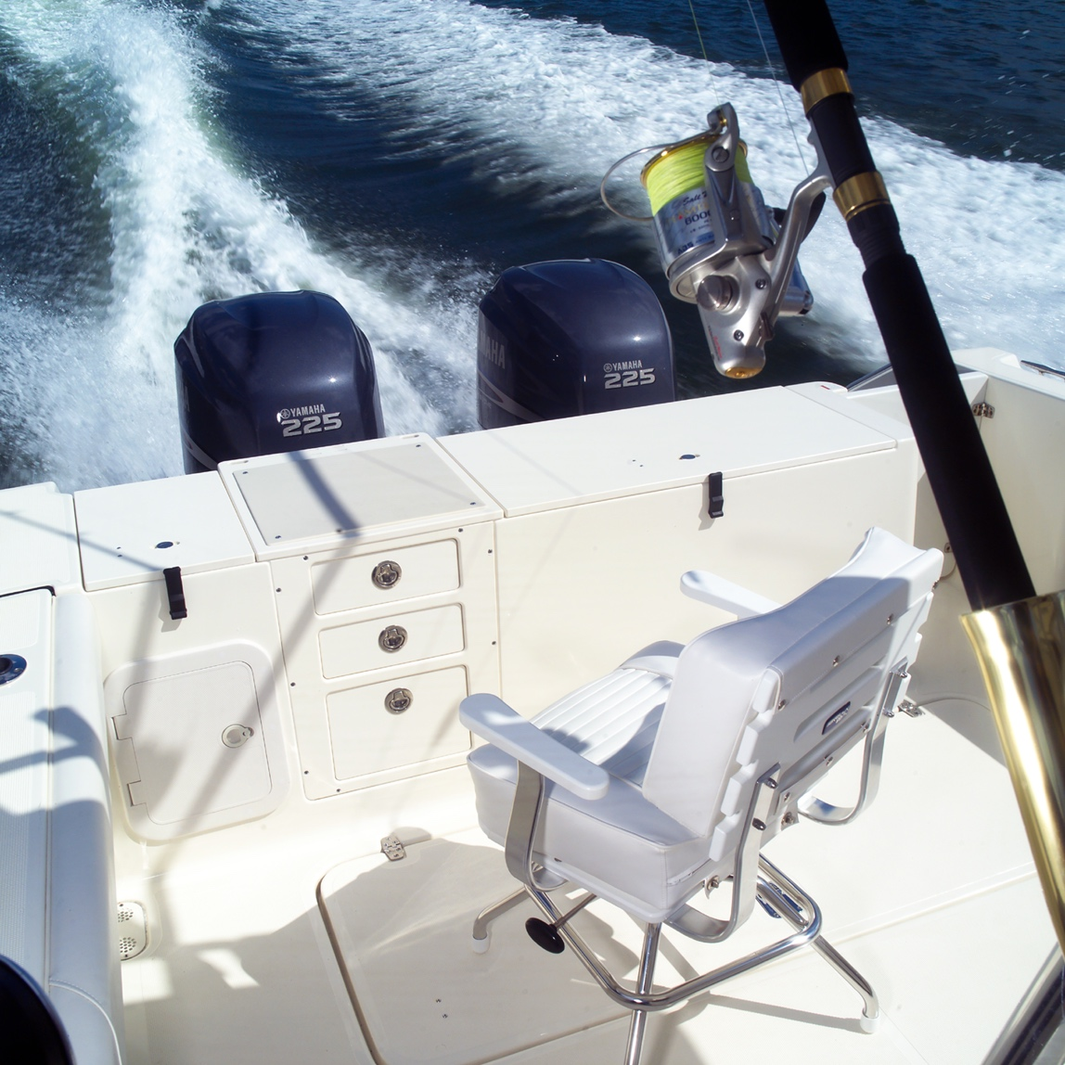
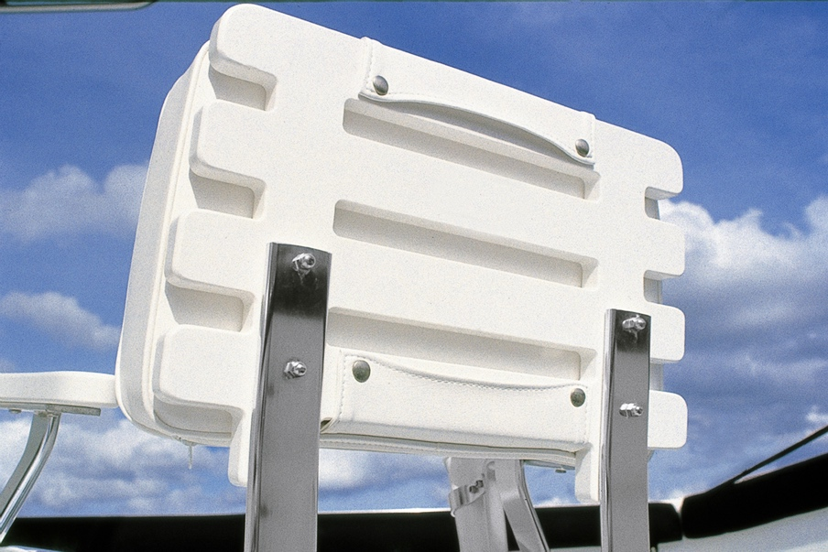
Notes:
Refer to Target Market Flyers and Case Study

Slide 20


















The Multi-Color Engravable Polymer Sheet
Standard Sheet Size: 48” x 96”
Standard Gauges: 1/4” | 1/2” | 3/4”
Approximate Weight: 40 lbs | 80 lbs | 120 lbs
Standard Colors

Slide 21
Notes:
Oceanside Harbor. Refer to Case Study

Slide 22
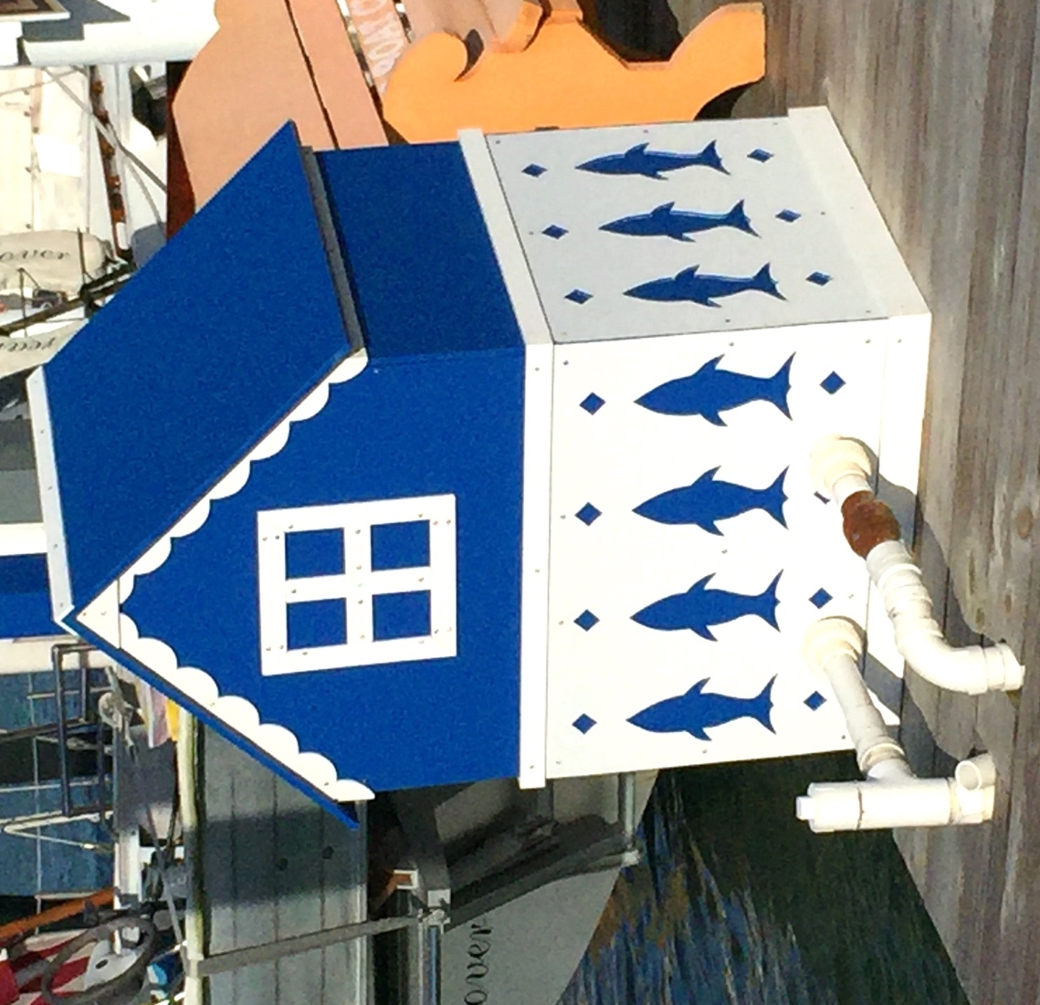
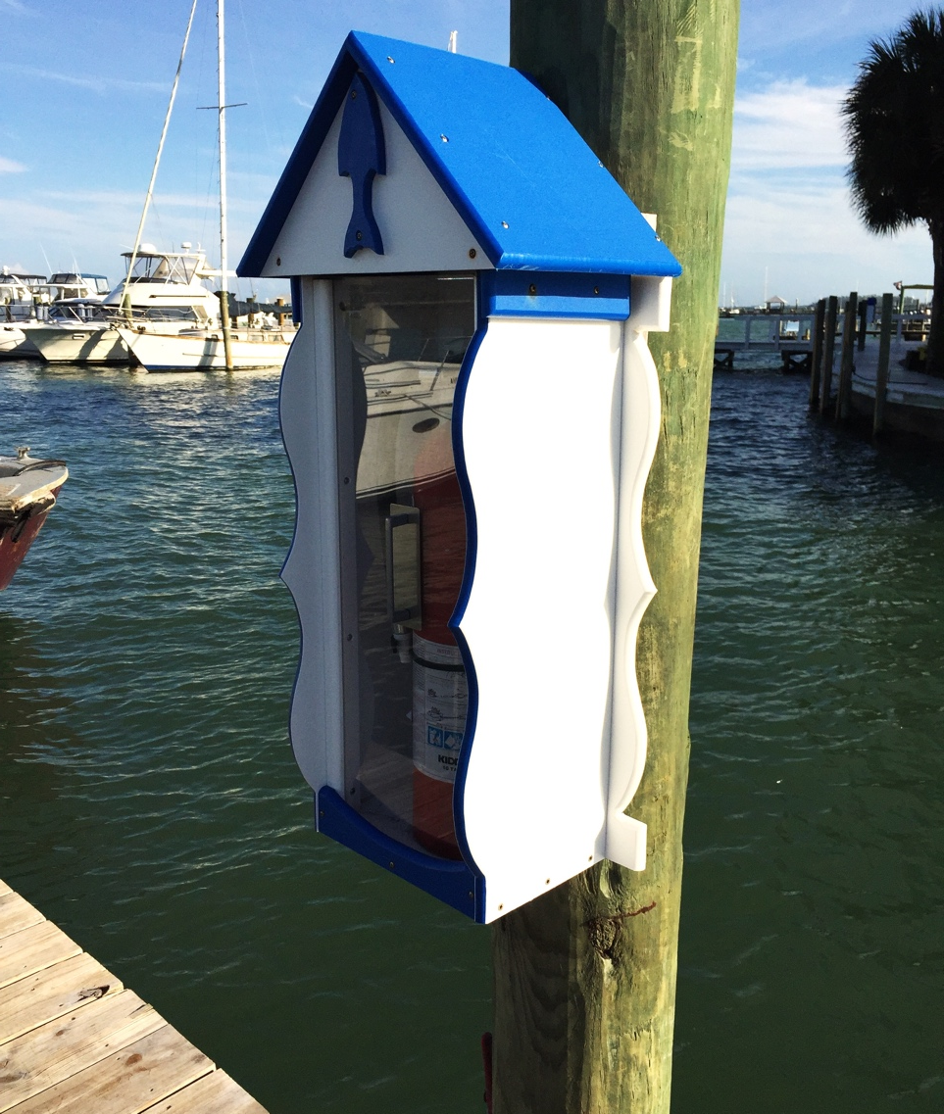
Notes:
Oceanside Harbor. Refer to Case Study

Slide 23
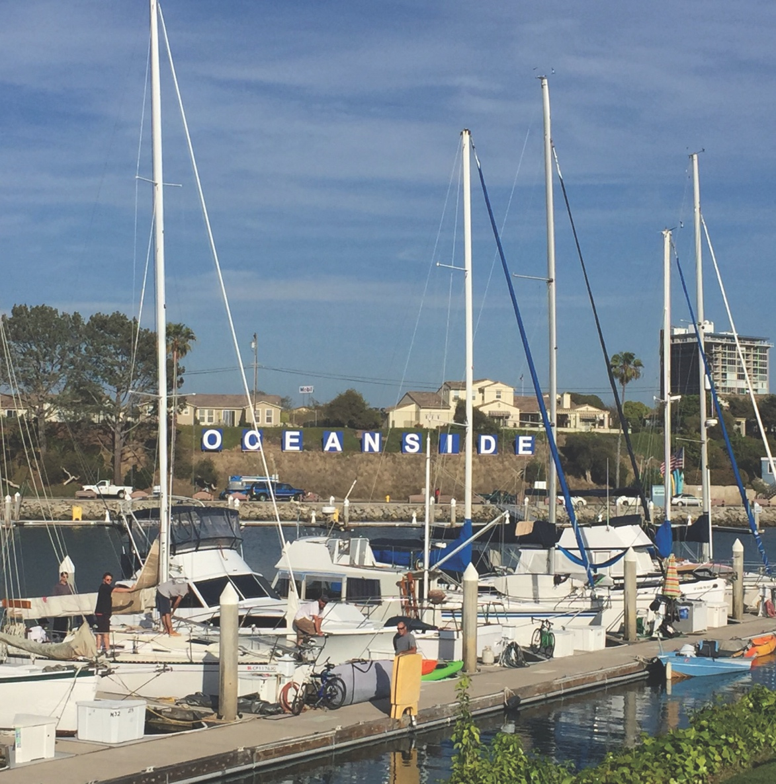
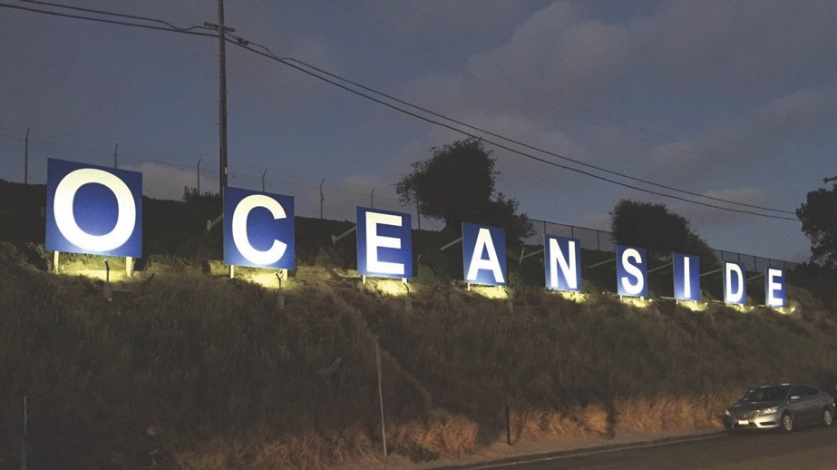
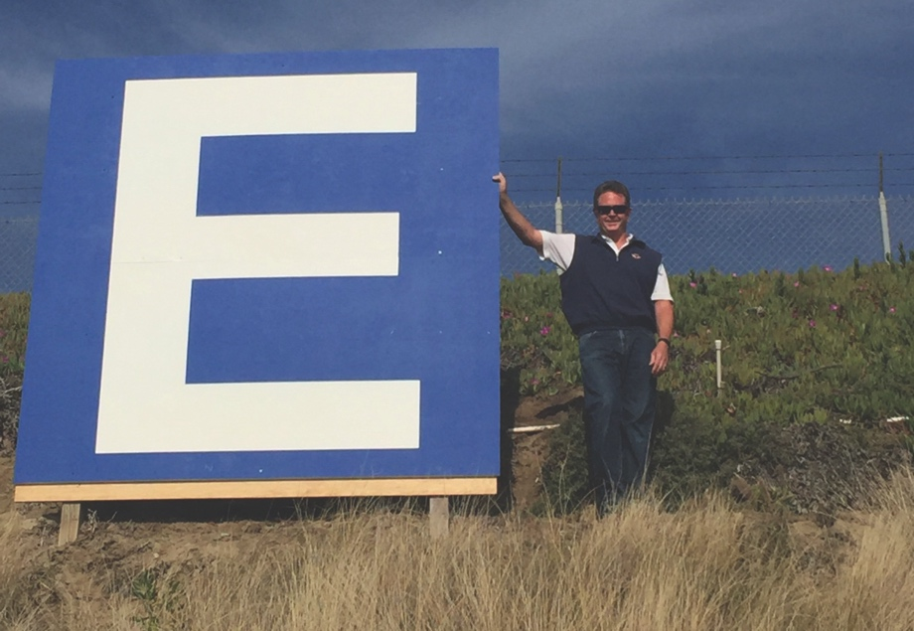
Outdoor Sign
Notes:
Oceanside Harbor. Refer to Case Study

Slide 24
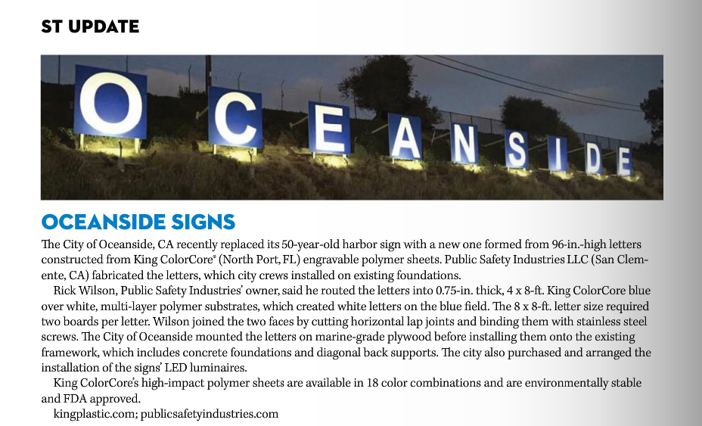
As Seen in Signs of the Times – January 2017
Notes:
Oceanside Harbor Editorial write up in Signs of the Times, January 2017

Slide 25
Support, Literature, Samples & Joint Calls
Literature
  Product Literature
  SDS
  Chemical Resistant Chart
  Expansion & Contraction Worksheet
Samples
  Product Sample Fan Decks for customer education
  Prototype Samples for customer evaluation
Joint Calls
  Fabricator / End User Calls
  Architectural Project Support
  Architectural, Fabricator & End User Product Training / Presentations

Slide 26

The End
Questions & Answers
Family of Products

Slide 27

Thank You
King Plastic Corporation
1100 N. Toledo Blade Blvd | North Port, FL 34288 USA
T: 941.493.5502 | F: 941.497.3274
E: sales@kingplastic.com
Our Innovation. Your Imagination.®
Please visit www.kingplastic.com for application ideas, fabrication tips, SDS and other details

